Slide 1
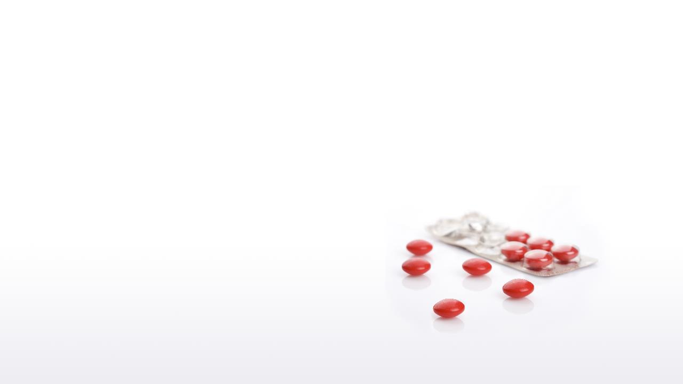

Taste-Masking film coating:
Kollicoat® Smartseal
BASF Pharma Solutions​

Slide 2
Taste-Masking film coating:
Kollicoat® Smartseal
BASF Pharma Solutions​

Slide 3
Agenda
  Introduction
  Items to be considered in the Kollicoat® Smartseal coating process
  Plasticizer
  Anti-tacking agent
  Curing step
  Decision tree
  Coating process
  Case Study: Vardenafil pellets coated with Kollicoat® Smartseal 30 D

Slide 4



Introduction to Taste-masking
Aging population
Treatment adherence
Bitter APIs
70%^{[1]}
61%^{[2]}
66%^{[3]}
nursing home residents with dysphagia
preference of ODT to standard tablets
currently in experimental and clinical stages
[1] SN Compr Clin Med. 2020 Aug 18 : 1–5.
[2] Patient Prefer Adherence. 2012; 6: 109–125.
[3] Sci Rep 7, 12074 (2017)
BASF Pharma Solutions - Orals Platform
Notes:
Globally, we have an aging population – attributed to declining fertility rates and rising life expectancies.
Global info on median age: https://www.pewresearch.org/fact-tank/2020/04/22/populations-skew-older-in-some-of-the-countries-hit-hard-by-covid-19/
As much as 70% of nursing home residents have dysphagia problems
In several published studies comparing patient preference and adherence to treatments given in redisperse tablets vs. standard tablets, as much as 61% of patients preferred the ODT and were also more adherent to treatment due to the additional benefits.
Bitter Predict suggests that about 40% of random molecules, and a large portion (66%) of clinical and experimental drugs, and of natural products (77%) are bitter.

Slide 5
Most Common (Intra)Oral Dosage Forms that might require a taste-masking approach
Intraoral products are classified on their disintegration speed.
Different technologies are employed for effective taste-masking.
Chewable dosage forms
(forced disintegration)
Orally disintegrating products
(fast disintegration)
Other dosage forms
(slow disintegration)
Chewable tablets
Medicated chewing gums
Soft lozenges
Orally disintegrating tablets (ODTs)
Oral lyophilized forms
Oral films
Orally dissolving granules (ODG)
Hard lozenges
Buccal tablets
Sublingual tablets
Solid single-unit dosage forms that disintegrate in the oral cavity
Gummies
Effervescent tablets
Differentiated forms
Sprinkles
Minitablets
Dispersible Pellets
BASF Pharma Solutions - Orals Platform
Notes:
Orally disintegrating tablets (ODTs) are an emerging dosage form that provides many benefits over traditional dosage forms for geriatric and pediatric patients, such as rapid disintegration within the oral cavity, and the reduction in the risk of choking.
Most impt attributes for pediatrics: https://journals.plos.org/plosone/article?id=10.1371/journal.pone.0193292

Slide 6
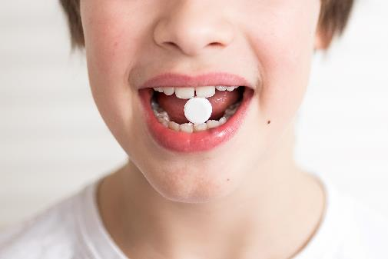
Introduction to taste-masking
Taste-masking is an efficient strategy to improve the unpleasant taste of APIs.
Many alternatives are available in the pharmaceutical industry to enhance drug taste:
Sweeteners
Flavors and aromas
Drug complexation: cyclodextrin / resins
Change API salt
Signal interruption
Emulsion: encapsulating drug in the internal phase
Film-coating
BASF Pharma Solutions - Orals Platform

Slide 7
Taste-masking approaches
Approach | Mechanism | Limitations
Use of flavors | Incorporation of a flavor (sweeteners and aromas) to reduce the bitterness. | Not feasible for very bitter drugs. Safety concerns (pediatrics formulations)
Change of API salt | Modify the drug to one with lower taste masking challenge (prodrug, alternative salt, freebase). | Increase R&D timeline. Potential pharmacokinetic changes. May still require additional masking approaches.
Complexation of API | Drug entrapped by a chemical matrix (cyclodextrin and ion exchange resin). | Might decrease drug loading. Potential pharmacokinetic changes. It is typically an expensive alternative.
Signal Interruption | Use an antagonist to inhibit taste: G-protein-coupled receptors (GPCRs) signal cascade blockers. | Must follow same receptor pathway as API. Functions best when administered before dose. New chemical entity.
Film coating | Application of a physical barrier (film coating or lipid) to cover the drug particle using a fluid bed or coacervation. | Processing time. High weight gain. Pharmacokinetics might change (insoluble films)
Film-coating is one of the most effective and robust.
BASF Pharma Solutions - Orals Platform

Slide 8
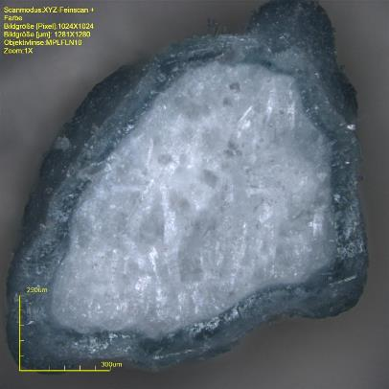
Introduction to Taste-Masking Film-Coating
A film-coating is a thin polymer-based coat that is typically sprayed on to a solid pharmaceutical dosage form, such as a tablet, capsule, pellet or granule.
Taste-masking film-coating technology is an approach used to surround the drug particles (powder, granules, pellets or mini-tablets) with a polymer.
The main objective is to reduce the contact of the drug and the taste buds by releasing the drug only after it has passed through the mouth.
BASF Pharma Solutions - Orals Platform

Slide 9
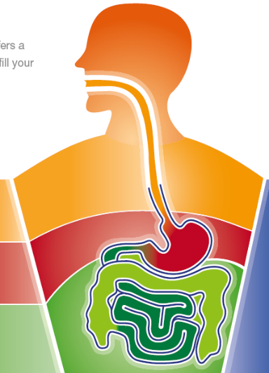


Kollicoat®: The BASF Coating Polymers
Kollicoat® line is a comprehensive portfolio, including polymers for instant release, gastric release, enteric release and sustained release.
Instant Release
Sustained Release
(pH independent)
(pH independent)
Gastric Release
(pH triggered)
Enteric Release
(pH triggered)

Slide 10
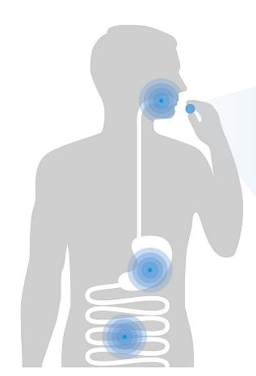
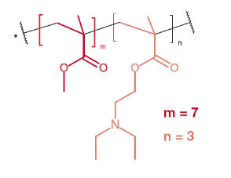
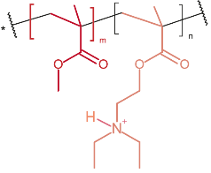
Kollicoat® Smartseal: Your first option for Taste-Masking Film-Coating
Copolymer of methyl- methacrylate & diethylaminoethyl methacrylate
pH ˃ 5.5
Insoluble in saliva
Deprotonated basic amino
functional group
⇒ No release
pH < 5.5
Readily soluble
in the stomach
Protonated basic amino functional group
⇒ Instant Release
BASF Pharma Solutions - Orals Platform
Notes:
Methyl methacrylate (MMA) : diethyl amino ethyl methacrylate (DEAEMA)
Alkaline in nature
Taxa de fluxo salivar
Em geral, estudos mostram que a taxa de fluxo salivar é menor em mulheres grávidas em comparação com mulheres não grávidas.
Os níveis de progesterona e estrogênio (estradiol, estriol e estrona) aumentam gradual e significativamente no momento da gravidez devido à secreção placentária desses hormônios. E a taxa de fluxo salivar diminui à medida
que o nível de progesterona e somatomamotropina coriônica humana aumenta.
pH salivar
O pH da saliva é influenciado pela taxa de fluxo salivar. Portanto, o pH salivar é maior em taxas de fluxo mais altas. Segundo estudos, o pH salivar de gestantes é inferior (mais ácido) ao de não gestantes.
Por exemplo, citando apenas alguns dos incluídos no estudo original, quando Rosenthal et al. analisaram o pH da saliva em mulheres grávidas e não grávidas, descobriram que a saliva das grávidas tinha um pH médio de 6,5, enquanto a das não grávidas tinha um pH médio de 7,0.
De acordo com Laine et al., o pH salivar cai à medida que a gravidez progride e então aumenta rapidamente após o parto.
Outros estudos observaram que alterações nutricionais, vômitos, variações na microbiota oral, mudanças na dieta e má higiene bucal desempenham um papel vital no desenvolvimento de cáries durante a gravidez.

Slide 11
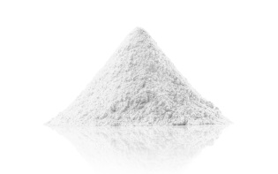
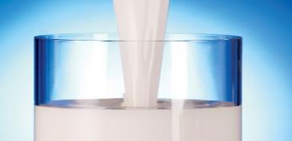
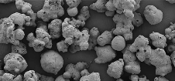
Kollicoat® Smartseal
Polymer Dispersion
Polymer Powder
Kollicoat® Smartseal 30 DP
Aqueous dispersion allowing for easy, reliable, and efficient processing.
For aqueous coating.
Kollicoat® Smartseal 100 P
For aqueous & organic coating.
Re-constitution of an aqueous dispersion after partial neutralization possible
Suitable for melting coating and HME
BASF Pharma Solutions - Orals Platform

Slide 12
Kollicoat Smartseal® film coating formulation & application guide
Antioxidant incorporation
Plasticizer selection
Anti-tacking agent
Curing step
Formulation summary
Application guide for Kollicoat® Smartseal 30 D
Application guide for Kollicoat ® Smartseal 100 P in water pre-neutralized with acid
Application guide for Kollicoat ® Smartseal 100 P in organic solvents
BASF Pharma Solutions - Orals Platform

Slide 13
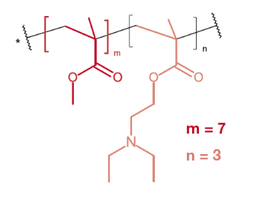
Kollicoat® Smartseal Formulation: Antioxidant Incorporation
Antioxidant | Amount
Butylated hydroxytoluene (BHT) | 1 - 2.5% related to polymer
N-acetylcysteine | 1 - 2.5% related to polymer
Sodium carbonate* | 1 - 2.5% related to polymer
*In aqueous coating, hydrophilic antioxidants can be used alternatively.
Basic amino
functional group
An antioxidant is recommended to stabilize the amino ester moiety of the polymer.
Antioxidant is mandatory for any Kollicoat® Smartseal film in close contact with lactose
Without it, yellowing and differences on the dissolution may appear under stress conditions.
BHT is the recommended antioxidant. Its plasticizing effect should be considered.
BASF Pharma Solutions - Orals Platform
Notes:
Antioxidants are recommended to increase the stability of the formulation
Cross-linking and yellowing of isolated polymer films and coatings that were applied to solid dosage forms was observed during storage. BHT is included in the FDA inactive ingredient guide with an upper registered limit max 0.4 mg/ tablet. At a use level of 2.5% where BHT (based on the polymer) is used, this would theoretically limit the amount of polymer to 16 mg/tablet. BHT (E 321) has a long tradition of use in food (in the US as well as in Europe) and the safety is well documented in the literature.

Slide 14
Kollicoat® Smartseal Formulation: Plasticizer
  Kollicoat® Smartseal: MMA : DEAEMA (7:3) copolymer
  Tg: ∼ 63 °C
  MFFT: ∼ 57 °C
  Water doesn‘t act as a plasticizer: Tg ≈ MFFT
Plasticizers are used to improve film elasticity and flexibility of high brittle polymers by increasing polymer chains mobility.
Higher mobility reduces the polymer glass transition (Tg) and the required minimum film forming temperature (MFFT).
Kollicoat® Smartseal require a plasticizer to reduce MFFT in aqueous films.
A hydrophobic plasticizer is preferred due to the lipophilicity of the polymer
Lack of plasticizer can lead to a polymer crack
BASF Pharma Solutions - Orals Platform

Slide 15
Kollicoat® Smartseal Formulation: Plasticizer
Tg₂ and Tm₂ of Kollicoat® Smartseal films,
as function of plasticizer (plasticizer content 13%)
Film formulation
  Kollicoat® Smartseal 30 D 88.5%
  Plasticizer (13%) 11.5%
Preparation isolated films
  Method sprayed onto a Teflon roll
  Spray rate 7.0 g/min
  Tube diameter 1 mm
  Nozzle bore 0.8 mm
  Nozzle speed 2.5
  Distance nozzle from roll 5.5 cm
  Roll speed 1.8
  Spraying pressure 1.0 bar
  Heater temperature ~110°C
  Film surface temperature 32 – 34°C
  Layer thickness 75 – 100 µm
T_{g} measuring
  Equipment DSC Q2000 V24.4 Build 116
  Sample 8 – 9 mg
  Preparation prev. fast cooling from 150°C
  Heating 20 K/min
  Value n=1
Kollicoat® Smartseal
BASF Pharma Solutions - Orals Platform

Slide 16
Kollicoat® Smartseal Formulation: Plasticizer + BHT
T_{g2} of Kollicoat® Smartseal films, as function of plasticizer (13%) and BHT (2.5%)
Film formulation (without BHT)
  Kollicoat® Smartseal 30 D 88.5%
  Plasticizer 11.5%
Film formulation (with BHT)
  Kollicoat® Smartseal 30 D 86.6%
  Plasticizer 11.2%
  Butylated hydroxytoluene (BHT) 2.2%
Preparation isolated films
  Method sprayed onto a Teflon roll
  Spray rate 7.0 g/min
  Tube diameter 1 mm
  Nozzle bore 0.8 mm
  Nozzle speed 2.5
  Distance nozzle from roll 5.5 cm
  Roll speed 1.8
  Spraying pressure 1.0 bar
  Heater temperature ~110°C
  Film surface temperature 32-34°C
  Layer thickness 75-100 µm
T_{g} measuring
  Equipment DSC Q2000 V24.4 Build 116
  Sample 8-9 mg
  Preparation prev. fast cooling from 150°C
  Heating 20 K/min
  Value n=1
Kollicoat® Smartseal
BHT acts as a plasticizer
BASF Pharma Solutions - Orals Platform

Slide 17
Kollicoat® Smartseal Formulation: Plasticizer + BHT
Elongation at break as function of type of plasticizer and BHT content
Film formulation (without BHT)
  Kollicoat® Smartseal 30 D 88.5%
  Plasticizer 11.5%
Film formulation (with BHT)
  Kollicoat® Smartseal 30 D 86.6%
  Plasticizer 11.2%
  Butylated hydroxytoluene (BHT) 2.2%
Preparation isolated films
  Method sprayed onto a Teflon roll
  Spray rate 7.0 g/min
  Tube diameter 1 mm
  Nozzle bore 0.8 mm
  Nozzle speed 2.5
  Distance nozzle from roll 5.5 cm
  Roll speed 1.8
  Spraying pressure 1.0 bar
  Heater temperature ~110°C
  Film surface temperature 32-34°C
  Layer thickness 75-100 µm
  Curing conditions 4 h / 70°C
Elongation at Break
  Texture analyser TA XT2i
  Climatic conditions 23°C/56% r.h.
  Value mean (n=6), ±SD
BHT has a distinctive influence on the elasticity and plasticity of the Kollicoat® Smartseal film. High values can be achieved when BHT is added.
BASF Pharma Solutions - Orals Platform

Slide 18
Kollicoat® Smartseal Formulation: Plasticizer
Tg,
MFFT
Product
temperature
Plasticizer^{1,2}
Film formation
Tackiness
Anti-tackiness
measures
Low
High
High
15%
+++
Below 35°C
Add talc
Medium
13%
++
Recommended: 37-39°C
Curing – water-based coatings
Add talc
or blend
afterwards
Low
10%
+/0
Above 40°C
High
1 - Plasticizer content based on dry polymer weight
Low
2 - The plasticizing effect of BHT needs also to be considered.
Process conditions (product temperature and curing step) and coating formulation (anti-tacking agent) must
be adjusted to the plasticizer content.
BASF Pharma Solutions - Orals Platform
Notes:
Pan coater:
Product temperature > 40°C: Increased risk of spray drying
Product temperature < 35°C: Increased risk of insufficient film formation

Slide 19
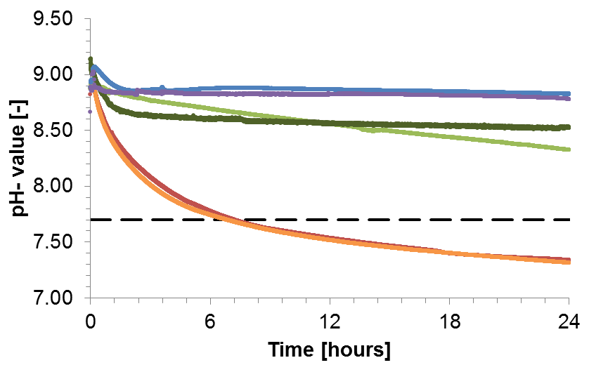
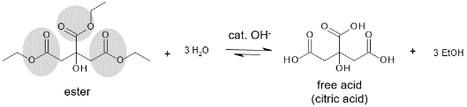

Kollicoat® Smartseal Formulation: Plasticizer
Dispersion stability is dependent on the plasticizer type (13% plasticizer)
TEC (triethyl citrate)
TAC (triacetin)
ATEC (acetyltriethyl citrate)
ATBC (acetyltributyl citrate)
DBS (dibutyl sebacate)
P 124 (poloxamer 124)
Recommended
Plasticizers
pH 7.8
= Isoelectric point of the dispersion
Zeta potential = zero
Dispersion no longer stable
TEC Hydrolysis
Reaction
Neutralization
BASF Pharma Solutions - Orals Platform

Slide 20
Kollicoat® Smartseal Formulation: Plasticizer
Several plasticizers can be used in combination with Kollicoat® Smartseal. See the most recommended ones:
Tributyl citrate (TBC)
Acetyltriethyl citrate (ATEC)
Acetyltributyl citrate (ATBC)
Dibutyl sebacate (DBS)
Recommended plasticizers:
Optimal concentration:
10 – 15% w/w
(calculated on the dry polymer)
BASF Pharma Solutions - Orals Platform

Slide 21
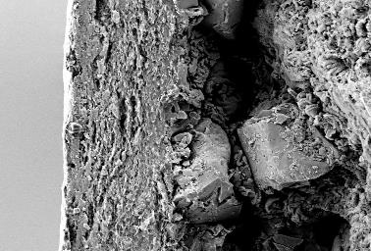
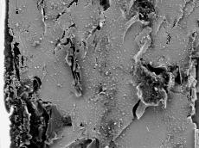
Kollicoat® Smartseal Formulation: Anti-tacking
Kolliwax® GMS II + Kolliphor® PS 80
C O A T
Anti-tacking agents are used to reduce Kollicoat® Smartseal tackiness during storage or when a higher amount of plasticizer is required in the formulation (also consider BHT impact on its plasticizing effect).
Talc is the most used anti-tacking.
Considerations:
It can precipitate in the tubes
Increase film-coating porosity → requires ↑ weight gain
Glycerol mono stearate [Kolliwax® GMS II] + Polysorbate 80 [Kolliphor® PS 80] (8:2) is an interesting alternative to talc:
Doesn’t precipitate in the tubes
Require less amounts compared to talc
Consideration: They need to be heated (70° C) and emulsified using a high shear mixer.
C O R E
1000 1
20µm
Talc
3000 : 1
10µm
BASF Pharma Solutions - Orals Platform

Slide 22
Kollicoat® Smartseal Formulation: Anti-tacking agent
An anti-tacking agent is recommended to reduce particles, pellets, and tablets sticking, especially after the coating process.
Preference Order | Procedure | Advantage
1 | Add talc to formulation or blend afterwards | Easiest application + excellent results
2 | Magnesium stearate dry blending | Easiest application
3 | Kollicoat® IR + talc (after coating) | Excellent results
4 | Magnesium stearate + Kolliphor® SLS (top coating) | Excellent results
5 | Kollicoat® IR top coating | Excellent results, might be more difficult to apply to small particles than proposal #3
It is recommended the use of 2 – 8% w/w talc in the total formulation. The less the better for the film functionality.
BASF Pharma Solutions - Orals Platform
Notes:
Talc of 2-8% w/w in formulation correspond to 10-40% in dry film.

Slide 23
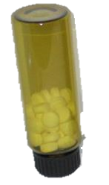
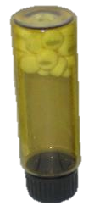
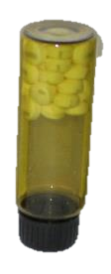
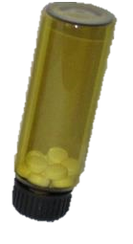
Kollicoat® Smartseal Formulation: Anti-tacking agent
0% Talc
1% Microtalc (after)
4% Talc
6% Talc
8% Talc
+
-
Taste-Masking Functionality
After 5.5 months at 30°C and 40°C / 75% RH, coated tablets blended with 1% Microtalc and those with 8% talc in the film formulation did not stick together.
However, adding more talc decreases the taste-masking functionality, requiring extra film coating.
BASF Pharma Solutions - Orals Platform
Notes:
Smartseal 30 D cores
Kollicoat ®Smartseal 30D- 15%ATBC-2,5%BHT-x%Talc
After 5.5 months of Storage at 30°C 75% RH as well as 40°C 75% RH, the Tablets are glued with 4+6%Talc. The Cores with 8%Talc, on the other Hand, are not. The Nuclei that did not contain Talc in the Recipe were powdered with 1% Microtalk before Storage. There was no Bonding in these Camps either. Puders with 1% Microtalk is recommended.

Slide 24
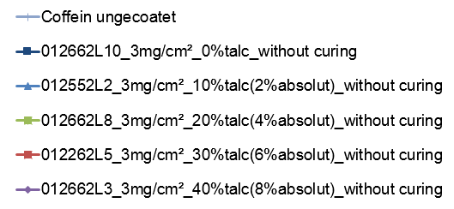
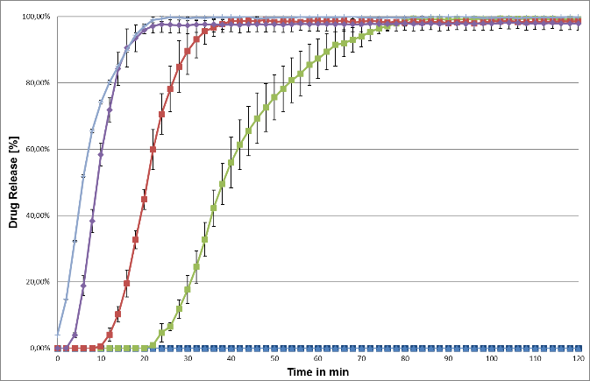
Kollicoat® Smartseal Formulation: Anti-tacking agent
Dissolution at pH 6.8 for tablets of caffeine coated with Kollicoat® Smartseal 30 D
Caffeine uncoated
Increasing concentrations of talc decrease film resistance at pH 6.8.
Curing step is required.
Avoid adding too much talc in the formulation.
BASF Pharma Solutions - Orals Platform
Notes:
Kollicoat ®Smartseal 30D – 15 % ATBC, 2.5% BHT, varying amounts of talc
(FS in PP pH=6,8, ohne Curing n=3)

Slide 25
Kollicoat® Smartseal Formulation: Anti-tacking agent summary
Talc content (% w/w)
In Coating
Suspension
Based on
Dry film
Tackiness
Resistance at
pH 6.8
Measures
High
8%
40%
0
coating level
3-4 mg/cm²
4 - 6%
20 - 30%
+
coating level
2-3 mg/cm²
Curing
Medium
Low
coating level
2 mg/cm²
0 - 2%
0 -10%
++
High talc concentrations in the film coating reduce the resistance at pH 6.8.
Curing is recommended after aqueous coating to ensure complete film forming.
BASF Pharma Solutions - Orals Platform

Slide 26
Kollicoat® Smartseal: Evaluation of curing effects
Curing
Quantity
of plasticizer and talc
Antioxidant (BHT level)
Aqueous dispersion or organic solution
Process parameters, especially product temperature
Final drying step
Curing step is required to close the film better when spraying a Kollicoat Smartseal dispersion.
Not needed for organic solutions of Kollicoat® Smartseal 100 P
Curing time depends upon formulation and process parameters.
Higher amounts of plasticizer, antioxidant, and talc in the formulation generally require longer curing time.
BASF Pharma Solutions - Orals Platform
Notes:
It is very difficult to give a genereal recommendation about the necessity for curing. The chart shows that curing effects depend not only on the properties of Kollicoat Smartseal 30 D or the coating formulation, but may be influenced by other factors of the formulation or manufacturing. We should always recommend to customers that they should look into this topic and define a study based on their formulation and process parameters.

Slide 27
Caffeine granules
15% weight gain
Kollicoat Smartseal 30 D aqueous:
No curing step and Curing
Kollicoat Smartseal 100 P organic:
No curing step and Curing
Kollicoat® Smartseal: Evaluation of curing effects
Effect of curing on taste masking and dissolution at pH 6.8
  Kollicoat® Smartseal 30 D needs curing to close. However, no practical difference in 2 vs 4 hrs. curing.
  Curing has no influence on performance of organic coated Kollicoat® Smartseal 100 P
  Organic Kollicoat® Smartseal 100 P w/o curing is initially comparable to release from Kollicoat® Smartseal 30 D cured
BASF Pharma Solutions - Orals Platform
Notes:
30 D is approx. 40% w/w in suspension
Coated caffeine granules partly compressed with Ludiflash / Kollidon CL-SF into ODTs

Slide 28
Decision tree for formulation development
Plasticizer
10%*
12.5%*
15%*
0-10%
20-30%
40%
Talc
Based on dry film
Tg/ MFT
High
Medium
low
High
Medium
Low
Tackiness
After coating
Film formation
+
++
+++
++
++
0
Resistance
at pH 6.8
Tackiness
Low
Medium
High
2–3 mg/cm²
3-4 mg/cm²
4-5 mg/cm/²
Coating
level
Coating
temperature
Recommended: 34-39°C
Curing recommended for aqueous coatings
Curing
>40 °C
<35 °C
2.5%*
Anti-tackiness
measure
Add talc or blend afterwards
Add talc
Antioxidant
Ingredient | Recommendation
Plasticizer | DBS or ATBS
Antioxidant | BHT
Anti-tacking | Talc or GMS II + PS 80
*related to dry polymer
BASF Pharma Solutions - Orals Platform

Slide 29
Summary of Kollicoat® Smartseal Formulations:
Kollicoat® Smartseal 30 D (aqueous) and Kollicoat® Smartseal 100 P (organic solvent)
Ingredient | Concentration | Recommended
Plasticizer | 10-15 %* | ATBS, DBS
Antioxidant | 2.5%* | BHT
Anti-tacking | 0 – 40% based on total film mass | Talc and Kolliwax® GMS II + Kolliphor® PS 80
Solvent: K. Smartseal 30 D | q.s. 20 % solid content | Water
Solvent: K. Smartseal 100 P | q.s. 10 - 20% solid content | Acetone / Acetone : Isopropanol 1:1 or 1:2
Kollicoat® Smartseal 100 P (aqueous – pre-neutralized)
Ingredient | Concentration | Recommended
Plasticizer | 10-15 %* | ATBS, DBS
Antioxidant | 2.5%* | BHT
Pre-neutralizing agent | 2.5%* | Succinic acid
Anti-tacking | 0 – 40% based on total film mass | Talc and Kolliwax® GMS II + Kolliphor® PS 80
Solvent | q.s. 20 % solid content | Water only
*related to dry polymer weight
BASF Pharma Solutions - Orals Platform

Slide 30
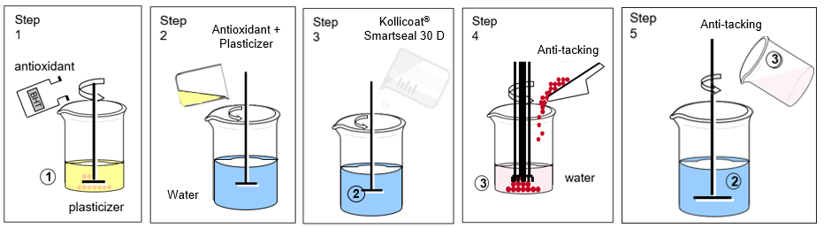
Application guide Kollicoat® Smartseal 30 P: Preparation of the aqueous coating dispersion
Aqueous dispersion - (20 % solids content)
Dissolve the antioxidant in the plasticizer. Elevated temperatures (~50°C)
speed up the process.
Add a part of water to the main vessel then add the plasticizer + antioxidant solution. Stir for 5 minutes.
Add the Kollicoat® Smartseal 30 D in the main vessel under stirring.
Disperse the anti-tacking agent in water with a high shear mixer for 10 minutes.
Add the anti-tacking suspension (3) to the Kollicoat® Smartseal 30 D dispersion in the main vessel (2). Stir for at least 1 hour.

Slide 31
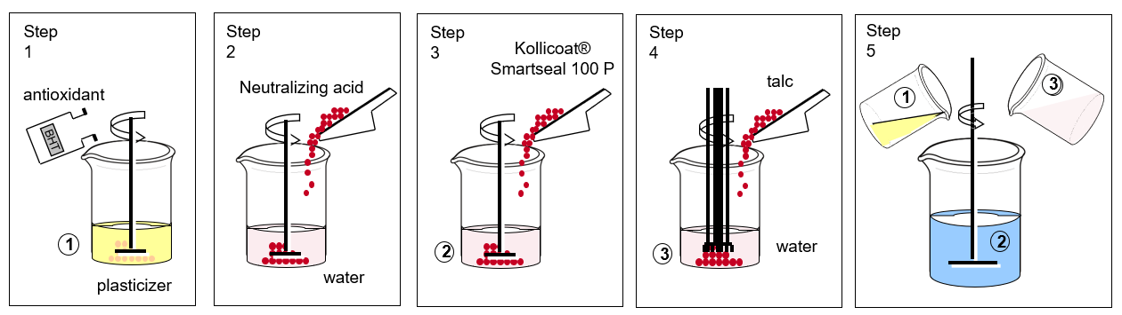
Application guide Kollicoat® Smartseal 100 P: Preparation of the aqueous coating suspension
Aqueous redispersion requires partial neutralization with a weak acid - (20 % solids content)
Dissolve the antioxidant in the plasticizer. Elevated temperatures (~50°C)
speed up the process.
Dissolve the succinic acid in water until a solution is obtained (recommendation is 1 mol /L aqueous solution or ~2.5% of the dry polymer amount).
Add Kollicoat® Smartseal 100 P to the acid solution and stir for 10 min until the polymer is fully redispersed.
Disperse the anti-tacking agent into water with a high shear mixer for 10 minutes.
Add the anti-tacking suspension (3) to the redispersed Kollicoat® Smartseal 100 P (2) and add the mixture of plasticizer and antioxidant (1).
Stir for at least 1 hour.

Slide 32
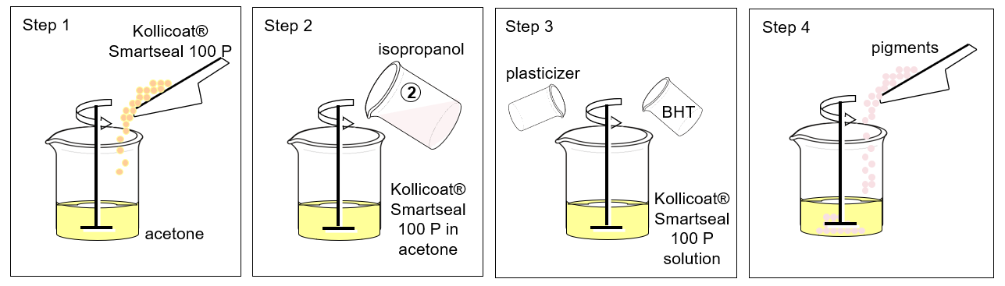
Application guide Kollicoat® Smartseal 100 P: Preparation of the organic coating solution
Preparation of Coating Solution (10-20% solids content)
Dissolve the polymer in acetone while stirring.
Add isopropanol to the fully dissolved acetone solution until the targeted mixture is reached. The maximum is a 1:2 mixture of acetone : isopropanol. Recommended is 1:1.
Add plasticizer and antioxidant to the organic solution and stir for 10 min or until both are fully incorporated.
Add anti-tacking agent to the organic solution.
Still the final coating preparation for at least 1 hour.
BASF Pharma Solutions - Orals Platform

Slide 33

Obtaining a taste-masking functionality for vardenafil pellets coated with Kollicoat® Smartseal 30 D: formulation evaluation and optimization
BASF Pharma Solutions

Slide 34
Main objective
Coat inert MCC pellets with vardenafil HCl and Kollicoat® IR
Provide a taste-masking functionality by coating vardenafil pellets using Kollicoat® Smartseal 30 D
Kollicoat® Smartseal 30 D optimization and evaluation, regarding:
The use of BHT in the coating dispersion
Required weight gain of Kollicoat® Smartseal 30 D film-coating to achieve the taste-masking functionality
Study the effect of curing time and its impact on the drug release at acid and basic media.
MUPS formulation using different fillers (Ludiflash ®, Ludipress ®, and MCC 102) to optimize and evaluate their impact on the coated-pellets release (breakage and stability).
Super-accelerated stability study (50 °C/ 90% RH) of pellets coated with Kollicoat® Smartseal 30 D with and without BHT and MUPS with different fillers.
Work-in-progress: accelerated stability (40 °C/ 75% RH) – results after 6 M (started in May 2023)
34
BASF Pharma Solutions - Orals Platform

Slide 35
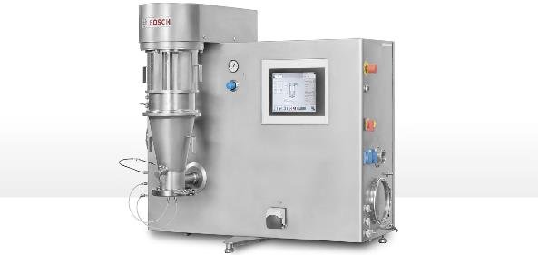
Vardenafil drug layering with Kollicoat® IR
Drug Loading Formula
Material Name | Qty per batch (g)
MCC Spheres (Cellets 200)* | 1000.0
Vardenafil HCL. 3H₂0 | 75.0
Kollicoat® IR | 25.0
Water | 400.0
*Pellets size 200-355 microns.
Drug Loading Process Parameters
Parameters | Observed Values
Inlet Temperature (⁰C) | 48.0 - 52.6
Inlet Airflow (m³/hr.) | 45 - 54
Product Temperature (⁰C) | 39.6 - 41.0
Exhaust Temperature (⁰C) | 38.1 - 39.3
Parameters | Observed Values
Atomization Air Pressure (bar) | 1.1 - 1.40
Microclimate Air Pressure (mbar) | 500
Spray Nozzle Size (mm) | 0.8
Spray Rate (g/min) | 0.8 – 1.5

Slide 36
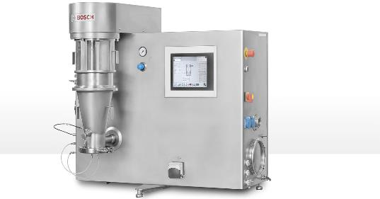
Kollicoat® Smartseal 30 D coating on vardenafil pellets
Coating Formula
Material Name | Qty per batch (g) | % solid in the dried formula
Vardenafil drug-loaded pellets | 250.0 | -
Kollicoat® Smartseal 30 D | 200.0 (60.0 g dry) | 80.0
Talc | 7.5 | 10.0
Acetyl Tributyl Citrate | 7.5 | 10.0
Purified Water | 160.0 | -
Kollicoat® Smartseal Coating Process Parameters
Parameters | Observed Values
Inlet Temperature (⁰C) | 39.0 – 41.0
Inlet Airflow (m3/hr.) | 35 - 50
Product Temperature (⁰C) | 34.2 – 35.4
Exhaust Temperature (⁰C) | 32.2 – 33.9
Parameters | Observed Values
Atomization Air Pressure (bar) | 1.0 – 1.1
Microclimate Air Pressure (mbar) | 600 - 700
Spray Nozzle Size (mm) | 0.8
Spray Rate (g/min) | 0.8 – 1.6

Slide 37
Comparative dissolution of vardenafil pellets coated with Kollicoat® Smartseal 30 D (uncured): 25% w/g Vs 30% w/g
Differences in the drug release at initial time points
Low standard deviation.
The study proceeded with a 30% weight gain coating.
BASF Pharma Solutions - Orals Platform
Notes:
Drug release at initial time points showed differences in 25% and 30% coating weight gain.
A minimal difference in drug release was observed at the end of dissolution.

Slide 38
Comparative dissolution of vardenafil pellets coated with Kollicoat® Smartseal 30 D (30% w/g): uncured Vs cured
Significant reduction in drug release was observed with the curing of pellets at 60 °C for 2 h.
The curing step in required for Kollicoat Smartseal 30 D (dispersion).
BASF Pharma Solutions - Orals Platform
Notes:
Significant reduction in drug release was observed with the curing of pellets at 60 °C for 2 h with fluidization motion for the pellets with 30% coating weight gain.
The curing step plays a vital role in the taste-masking functionality of the Kollicoat Smartseal 30 D (dispersion).
Drug release at pH 6.8 Phosphate buffer after 60 minutes:
uncured pellets: 33% of drug
cured pellets: 8% of drug

Slide 39
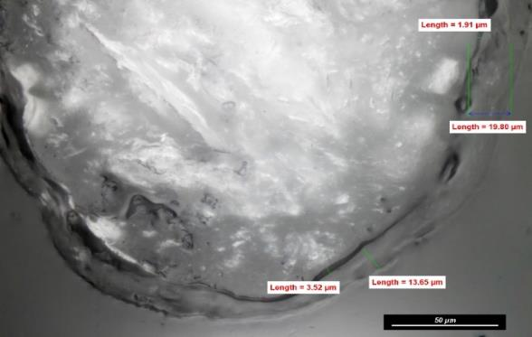
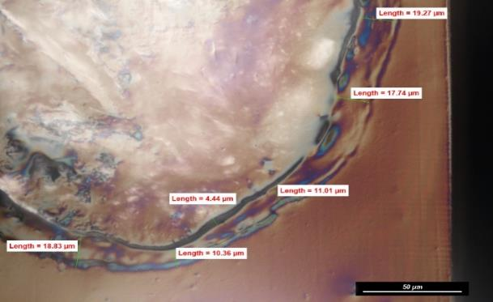
SEM Pictures of Vardenafil pellets coated with Kollicoat® Smartseal
Vardenafil-loaded pellets coated with Kollicoat® Smartseal 30 D cured for 2 hours at 60⁰C
MCC core
MCC core
Kollicoat Smartseal layer
Kollicoat Smartseal layer
®
Vardenafil + Kollicoat IR layer
Vardenafil + Kollicoat IR layer
BASF Pharma Solutions - Orals Platform

Slide 40
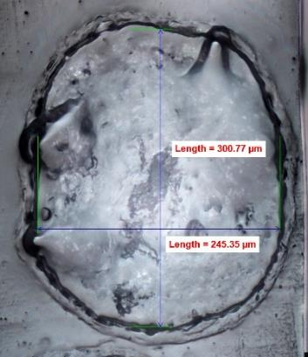
Particle size distribution (PSD) of vardenafil coated pellets
PSD of MCC pellets layered with Kollicoat® IR + vardenafil, then coated with Kollicoat® Smartseal (30% WG)
(SEM of cross section of pellet coated with vardenafil + Kollicoat® Smartseal – 30% WG)
Minimum: 290 µm Mean: 400 µm
Maximum: 594 µm Std.: Dev 75 µm
Inert MCC Pellets PSD: 200 – 355 µm
Narrow PSD (RSD 18.75%) → robust coating process
BASF Pharma Solutions - Orals Platform

Slide 41
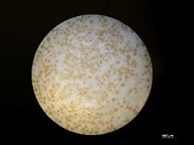
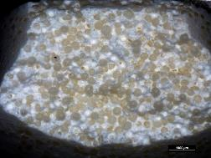
Vardenafil MUPS 10mg - Ludiflash®
MUPS Formulation
Materials | mg/tab
Vardenafil pellets coated with Kollicoat® Smartseal 30% w/g | 225.985 (eq. to 10mg of vardenafil)
Ludiflash®* | 225.47
Kollidon® CL SF (crospovidone) | 9.03
Sodium stearyl fumarate | 4.515
Total | 465.0
Compression Parameters – Styl’one Compaction Simulator
Parameters | Observed Values
Punch Dimension | 10mm round Std. Concave
Recipe | Korsch XL 100
Compression Pressure (kN) | 17
Ejection Force (N) | 150 - 170
Parameters | Observed Values
Tablet Weight (mg) | 463.4 – 482.3
Hardness (N) | 40 - 51
Disintegration Time (sec) | 23
Thickness (mm) | 5.45- 5.51
  *Ludiflash®
  D-mannitol
  Kollicoat® SR 30 D**
  Kollidon® CL-SF
  **Polyvinyl acetate (PVAc) +
  Kollidon® 30
BASF Pharma Solutions - Orals Platform

Slide 42
Comparative Dissolution: Vardenafil pellets vs Vardenafil MUPS
Vardenafil MUPS with Ludiflash® presented negligibly release differences compared to vardenafil pellets.
Overall, the tableting process is feasible for the pellets with Ludiflash® in the composition.
BASF Pharma Solutions - Orals Platform
Notes:
The difference in release could be due to a minimum breakage of pellets on the tablet surface during compression.

Slide 43
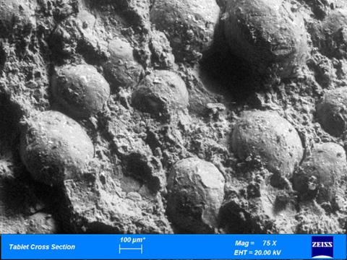
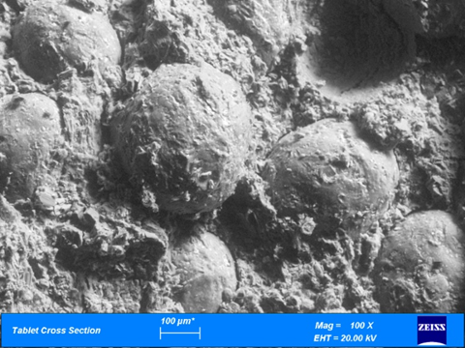
SEM of tablet cross section showing the pellets surface
Vardenafil pellets coated with Kollicoat® Smartseal 30 D tableted with Ludiflash ®
Tablet Cross Section 75x
Tablet Cross Section 100x
No apparent pellet cracking after tableting with Ludiflash®
Formulated Kollicoat® Smartseal forms an elastic film suitable for MUPS
BASF Pharma Solutions - Orals Platform

Slide 44
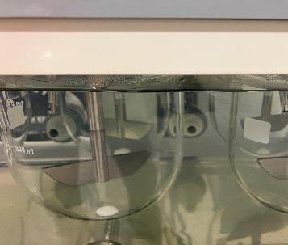
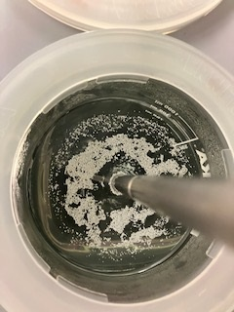
Dissolution observation: uncured pellets and cured pellets coated with Kollicoat® Smartseal 30 D
Uncured pellets Cured Pellets
Majority of pellets are reaching to bottom during dissolution with small number of pellets floating on top of the medium.
Majority of pellets are floating on top of the medium with minimum pellets reaching the bottom.
BASF Pharma Solutions - Orals Platform

Slide 45
Dissolution of vardenafil pellets coated with Kollicoat® Smartseal in pH 6.8 buffer: basket Vs paddle
Basket was tested in the dissolution test and compared to the paddle results.
Both Basket and Paddle apparatus showed similar release patterns.
Next trials were tested using basket.
BASF Pharma Solutions - Orals Platform
Notes:
To overcome the floating cured-pellets issue, basket was tested in the dissolution test and compared to the paddle results.
Vardenafil pellets with 30% coating weight gain, cured for 2 hours at 60 °C.
Both Basket and Paddle apparatus showed similar phosphate buffer pH 6.8 release patterns.
Next trials were tested using basket.

Slide 46
Effect of curing step on vardenafil pellets coated with Kollicoat® Smartseal 30 D at 30% weight gain (w/g)
A curing step is recommended when working with Kollicoat® Smartseal 30 D dispersion.
In this formulation, all three curing times (1h, 2h, and 3h) at 60 °C presented similar drug release in the pH 6.8 buffer media.
2h curing time at 60 °C was selected to be used.
BASF Pharma Solutions - Orals Platform
Notes:
The curing step occurred in the same fluid bed used in the coating process.
A curing step is recommended when working with Kollicoat® Smartseal 30 D dispersion.
All three curing times (1h, 2h, and 3h) at 60 °C presented similar drug release in the pH 6.8 buffer media.
2h curing time at 60 °C was selected as the curing step condition for Kollicoat® Smartseal 30 D coating on vardenafil pellets.

Slide 47
Kollicoat® Smartseal 30 D coating on vardenafil pellets – scaled-up lab batch
Coating Formula
Material Name | Qty per batch (g) | % solid in formula
Vardenafil-loaded pellets | 750.0 | -
Kollicoat® Smartseal 30 D | 600.0 (180.0) | 80.0
Talc | 22.5 | 10.0
Acetyl Tributyl Citrate | 22.5 | 10.0
Purified Water | 480.0 | -
Scale-up lab batch:
Batch from 250 g to 750 g vardenafil-loaded pellets.
Kollicoat® Smartseal Coating Process Parameters – Solidlab
Parameters | Observed Values
Inlet Temperature (⁰C) | 41.0 – 48.3
Inlet Airflow (m³/hr.) | 40 - 60
Product Temperature (⁰C) | 35.1 – 37.1
Exhaust Temperature (⁰C) | 32.7 – 35.2
Parameters | Observed Values
Atomization Air Pressure (bar) | 1.25 – 1.50
Microclimate Air Pressure (mbar) | 600 - 626
Spray Nozzle Size (mm) | 0.8mm
Spray Rate (g/min) | 1.0 - 2.60
BASF Pharma Solutions - Orals Platform

Slide 48
Comparative dissolution of vardenafil Kollicoat® Smartseal 30 D coated pellets- 25%w/g Vs 30%w/g – scaled-up lab batch
Small-lab scale or scaled-up lab batches presented similar behavior.
The curing step at 60 °C for 2 hours effectively reduced the drug release.
Pellets coated with 30 % w/g have demonstrated significant taste-masking functionality.
BASF Pharma Solutions - Orals Platform
Notes:
Small-lab scale or scaled-up lab batches presented similar behavior for cured and uncured pellets.
25% uncured pellets: Small: 38% / S-Up: 52%
25% cured pellets: Small: NA/ S-Up: 16%
30% uncured pellets: Small: 33% / S-Up: 28%
30% cured pellets: Small: 8% / S-Up: 5%
The curing step at 60 °C for 2 hours effectively reduced the drug release for the pellets coated with Kollicoat® Smartseal 30 D dispersion.
Pellets coated with 30 % w/g have demonstrated significant taste-masking functionality.

Slide 49
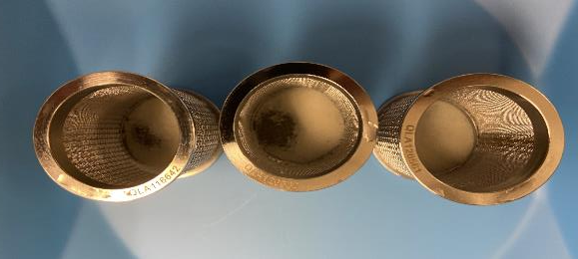
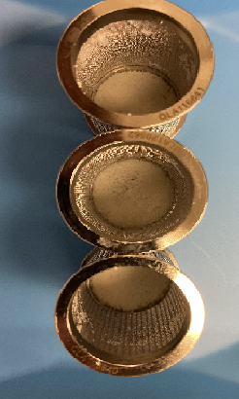
Dissolution observation of vardenafil pellets coated with Kollicoat® Smartseal 30 D in basket apparatus
Pellets remaining in the basket after dissolution
25% Coated Cured pellets
30% Coated Cured pellets
Dissolution conditions:
Basket: 100 rpm
Media: Phosphate buffer, pH 6.8 at 37 °C ± 0.5 °C
Volume: 900 ml
Basket apparatus with fine mesh (150 microns) ensures the exposure of all Kollicoat® Smartseal coated pellets during dissolution. Coated pellets didn’t dissolve.
BASF Pharma Solutions - Orals Platform

Slide 50
Impact of BHT on Kollicoat® Smartseal 30 D film-coating
Coating Formula
Material Name | Qty per batch (g) | % solid in Coating formula
Vardenafil-loaded pellets | 750.0 | -
Kollicoat® Smartseal 30D | 176.49 (588.3) | 78.44
Talc | 22.05 | 9.80
Acetyl Tributyl Citrate | 22.05 | 9.80
Butylated Hydroxytoluene | 4.41 | 1.96
Purified Water | 488.19 | -
Kollicoat® Smartseal Coating Process Parameters – Solidlab
Parameters | Observed Values
Inlet Temperature (⁰C) | 42.3 – 50.3
Inlet Airflow (m3/hr.) | 45 - 60
Product Temperature (⁰C) | 36.1 – 37.2
Exhaust Temperature (⁰C) | 32.3 – 36.0
Parameters | Observed Values
Atomization Air Pressure (bar) | 1.25 – 1.47
Microclimate Air Pressure (mbar) | 600 - 650
Spray Nozzle Size (mm) | 0.8mm
Spray Rate (g/min) | 1.0 - 2.60
BASF Pharma Solutions - Orals Platform

Slide 51
Comparative Dissolution: vardenafil pellets coated with 30% w/g Kollicoat® Smartseal 30 D + BHT: uncured Vs cured
Vardenafil release was higher in the film-coating with BHT:
With BHT
uncured pellets: 40% of drug
cured pellets: 19% of drug
Without BHT
uncured pellets: 33% of drug*
cured pellets: 8% of drug*
The faster release could be attributed to the plasticizer effect of BHT in the coating film.
*data provided on previous slides. For comparison and reference only.
*data provided on previous slides. For comparison and reference only.
BASF Pharma Solutions - Orals Platform
Notes:
Significant reduction in drug release was observed with the curing of pellets at 60 °C for 2 hours with fluidization motion.
Vardenafil release was higher in the film-coating with BHT:
Without BHT
uncured pellets: 33% of drug*
cured pellets: 8% of drug*
With BHT
uncured pellets: 40% of drug
cured pellets: 19% of drug
The faster release could be attributed to the plasticizer effect of BHT in the coating film.

Slide 52
Effect of curing time on vardenafil pellets coated with Kollicoat® Smartseal 30 D + BHT
Both 1- and 2-hour curing steps at 60 °C with fluidized motion showed similar drug release in the phosphate buffer pH 6.8.
It was decided to keep the curing condition at 60 °C for 2 hours to match with pellets coated without BHT.
BASF Pharma Solutions - Orals Platform
Notes:
Both 1- and 2-hour curing steps at 60 °C with fluidized motion showed similar drug release in the phosphate buffer pH 6.8.
It was decided to keep the curing condition at 60 °C for 2 hours to match with pellets coated without BHT.

Slide 53
Comparative dissolution of vardenafil pellets coated with Kollicoat® Smartseal 30 D (with BHT & without BHT)
No differences in the drug release with the film-coating with and without BHT.
Kollicoat ® Smartseal provides a fast release in the acid environment.
BASF Pharma Solutions - Orals Platform
Notes:
No differences in the drug release with the film-coating with and without BHT.
More than 90% of the drug was released within 6 min of dissolution for 30% coating weight gain for Kollicoat ® Smartseal 30 D coated pellets with and without BHT.
Kollicoat ® Smartseal provides a fast release in the acid environment.

Slide 54
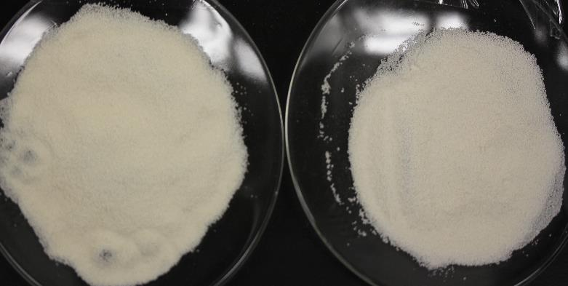
Stressed condition test (50°C and 90% RH)
Pellets after 1 week under the stressed condition: 50°C and 90% RH
Vardenafil pellets coated with Kollicoat ® Smartseal 30 D without BHT (after 1 week)
Vardenafil pellets coated with Kollicoat ® Smartseal 30 D with BHT (after 1 week)
After 1 week of stressed condition, pellets without BHT were slightly more yellow.
BASF Pharma Solutions - Orals Platform

Slide 55
MUPS of vardenafil 10 mg- Formulation – for stressed condition study:
Formulation of MUPS of vardenafil pellets coated with Kollicoat® Smartseal 30 D
Materials | mg/tab
 | MUPS w/ Ludiflash® | MUPS w/ Ludipress® | MUPS w/ MCC 102
Vardenafil pellets coated with Kollicoat® Smartseal 30% w/g (With and without BHT) | 225.985 (eq. to 10 mg of vardenafil base) | 225.985 (eq. to 10 mg of vardenafil base) | 225.985 (eq. to 10 mg of vardenafil base)
Ludiflash® | 221.135 | - | -
Ludipress® | - | 221.135 | -
MCC 102 | - | - | 221.135
Kollidon® CL SF (crospovidone) | 11.175 | 11.175 | 11.175
Fumed silica | 2.235 | 2.235 | 2.235
Sodium stearyl fumarate | 4.47 | 4.47 | 4.47
Total | 465.0 | 465.0 | 465.0
  Ludipress®
  α-lactose (1 x H₂O)
  Kollidon® 30
  Kollidon® CL
  Ludiflash®
  D-mannitol
  Kollicoat® SR 30 D*
  Kollidon® CL-SF
  *Polyvinyl acetate (PVAc) + Kollidon® 30
BASF Pharma Solutions - Orals Platform

Slide 56
MUPS of vardenafil 10 mg- Tableting
Compression Results – pellets without BHT
Parameters | MUPS w/ Ludiflash® | MUPS w/ Ludipress® | MUPS w/ MCC 102
Tablet Weight (mg) | 469.4 – 474.7 | 466.4 – 468.6 | 461.5 – 473.6
Hardness (N) | 64 - 89 | 43 - 52 | 80 - 101
Thickness (mm) | 5.52- 5.58 | 5.54 - 5.58 | 5.33 - 5.38
Disintegration Time (sec) | 20-24 | 40 - 44 | 12 - 18
Friability (%w/w) | 0.80 | 0.63 | 0.06
Parameters | Observed Values
Punch Dimension | 10 mm round concave
Machine | Korsch XL 100
Compression Pressure (kN) | 15 -18
Ejection Force (N) | 100 - 150
Compression Results – pellets with BHT
Parameters | MUPS w/ Ludiflash® | MUPS w/ Ludipress® | MUPS w/ MCC 102
Tablet Weight (mg) | 462.1 – 467.8 | 468.6 – 474.3 | 461.2 – 472.6
Hardness (N) | 75 - 87 | 44 - 50 | 86 - 109
Thickness (mm) | 5.43- 5.47 | 5.60 - 5.64 | 5.32 - 5.37
Disintegration Time (sec) | 20-22 | 50 - 58 | 16 - 22
Friability (%w/w) | 0.79 | 0.69 | 0.06
Parameters | Observed Values
Punch Dimension | 10 mm round concave
Machine | Korsch XL 100
Compression Pressure (kN) | 15 -18
Ejection Force (N) | 90 - 155
BASF Pharma Solutions - Orals Platform

Slide 57
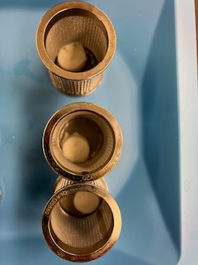
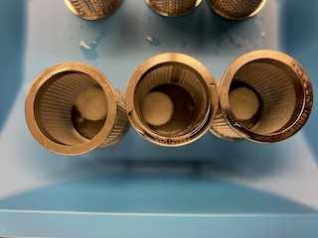
Stressed condition study (50°C and 90% RH): MUPS with Ludiflash®
Tablets remaining in the basket after dissolution
MUPS with Ludiflash® containing vardenafil pellets coated with Kollicoat® Smartseal 30 D without BHT (1 week under stressed condition)
MUPS with Ludiflash® containing vardenafil pellets coated with Kollicoat® Smartseal 30 D with BHT (1 week under stressed condition)
MUPS with Ludiflash® under the stressed condition after one week didn’t disintegrate during the dissolution study, regardless of the BHT addition, in both acid and basic media.
It might be caused by the PVAc from Ludiflash® when exposed to high humidity and temperature.
This formulation after the stressed condition is not included on the following charts.
BASF Pharma Solutions - Orals Platform

Slide 58
Stressed condition study: pellets coated with Kollicoat® Smartseal 30 D with BHT and vardenafil MUPS - 0.1 N HCl
Vardenafil was entirely released from the pellets and MUPS coated with Kollicoat® Smartseal 30 D with BHT for the initial and stressed samples.
All fillers demonstrated similar dissolution profile after two weeks of exposure.
BASF Pharma Solutions - Orals Platform
Notes:
Vardenafil was entirely released from the pellets and MUPS coated with Kollicoat® Smartseal 30 D with BHT for the initial and stressed samples.
Kollicoat® Smartseal film with BHT retains its reverse enteric properties in the stressed condition after two weeks of exposure – all fillers demonstrated similar dissolution profile.
Ludipress® MUPS presented a slower drug release compared to other fillers. It might be due to a slow disintegration.

Slide 59
Stressed condition study: pellets coated with Kollicoat® Smartseal 30 D with BHT and vardenafil MUPS-Phosphate Buffer pH 6.8
Very minimal drug release (less than 20%) was observed for samples of pellets and MUPS after two weeks in the stressed condition and initial phase.
Stressed samples of pellets and MUPS showed further reduction in the release compared to the initial stage.
BASF Pharma Solutions - Orals Platform
Notes:
Very minimal drug release (less than 20%) was observed for samples of pellets and MUPS after two weeks in the stressed condition and initial phase.
Stressed samples of pellets and MUPS showed further reduction in the release compared to the initial stage.
This effect might be due to a better film formation over time when using a dispersion coating system.
MUPS with MCC 102 presented a higher drug dissolution than the other fillers.

Slide 60
Super-accelerated stability study: Pellets coated with Kollicoat® Smartseal 30 D without BHT and vardenafil MUPS - 0.1 N HCl
Vardenafil was entirely released from the pellets and MUPS coated with Kollicoat® Smartseal 30 D without BHT for the initial and stressed samples.
Ludipress® MUPS, after the stressed condition, presented a faster drug release than in the initial stage.
BASF Pharma Solutions - Orals Platform
Notes:
Vardenafil was entirely released from the pellets and MUPS coated with Kollicoat® Smartseal 30 D without BHT for the initial and stressed samples.
Ludipress® MUPS, after the stressed condition, presented a faster drug release than in the initial stage.
Kollicoat® Smartseal film without BHT retains its reverse enteric properties in the stressed condition after two weeks of exposure - however, there are concerns about using lactose-based excipients and Kollicoat® Smartseal.

Slide 61
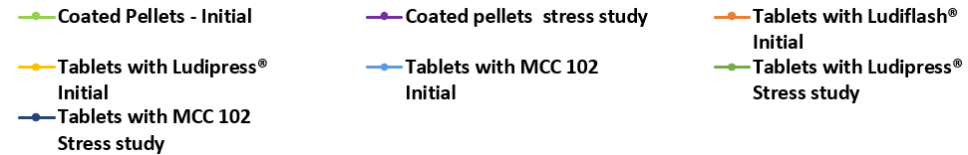
Stressed condition study: pellets coated with Kollicoat® Smartseal 30 D without BHT and vardenafil MUPS-Phosphate Buffer pH 6.8
Very minimal drug release (less than 20%) was observed for samples of pellets and MUPS after two weeks in the stressed condition and initial phase.
Stressed samples of pellets and MUPS showed further reduction in the release compared to the initial stage.
BASF Pharma Solutions - Orals Platform
Notes:
Very minimal drug release (less than 20%) was observed for samples of pellets and MUPS after two weeks in the stressed condition and initial phase.
Stressed samples of pellets and MUPS showed further reduction in the release compared to the initial stage.
This effect might be due to a better film formation over time when using a dispersion coating system. Obs.: all pellets in this test were cured for 2 hours.

Slide 62
Comparison of the drug release of pellets coated with & without BHT at the stressed condition study Vs initial
Vardenafil pellets coated with Kollicoat ® Smartseal 30 D with BHT, stressed condition. Dissolution in 0.1N HCl, 900 ml , basket at 100 rpm
Vardenafil pellets coated with Kollicoat ® Smartseal 30 D without BHT, stressed condition. Dissolution in 0.1N HCl, 900 ml , basket at 100 rpm
No differences on the drug release with BHT. A negligible drop in the final drug release was observed for pellets without BHT.
BASF Pharma Solutions - Orals Platform

Slide 63
Comparison of the drug release of Ludiflash® MUPS with pellets coated with & without BHT at room temperature Vs initial
No differences on the drug release with and without BHT for tablets with Ludiflash® after 4 weeks of storage at room temperature.
BASF Pharma Solutions - Orals Platform

Slide 64
Conclusion
Drug-layering with Kollicoat® IR was a straightforward and fast process.
Kollicoat® Smartseal provided pronounced taste-masking functionality over 25% weight gain for pellets of mean size 200-350 microns.
Curing is required for Kollicoat® Smartseal 30 D: 1 - 2 hours at 60 °C.
BHT (antioxidant) is recommended to be used in general.
BHT is required for lactose-based formulations.
Similar drug release at acid media for MUPS tablets and free pellets coated with BHT. Slightly lower release at pH 6.8 due to better film formation over time.
No differences for MUPS with Ludipress® and MCC after two weeks of stressed condition with BHT. Without BHT, the lactose-based formulation showed different release profile in the acid media.
BASF Pharma Solutions - Orals Platform

Slide 65
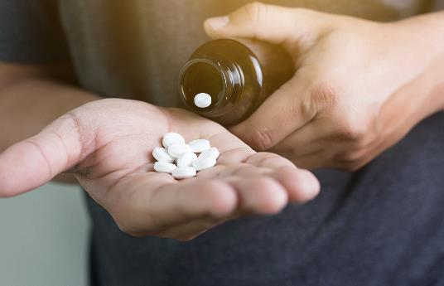
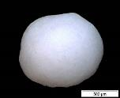
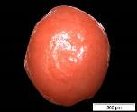
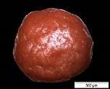
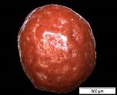
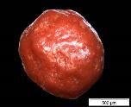
Kollicoat® Smartseal : Summary
The first protective polymer dispersion / new excipient
Efficient taste-masking
Easy-processing
Highly suitable for coating of particles, pellets and (mini)-tablets
Great option for taste-masking of ODT‘s formulations
Comprehensive safety assessment available
BASF Pharma Solutions - Orals Platform

Slide 67
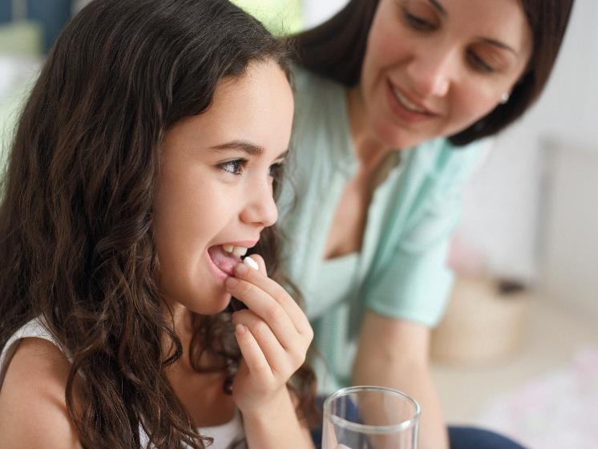
Regulatory and Safety

Slide 68
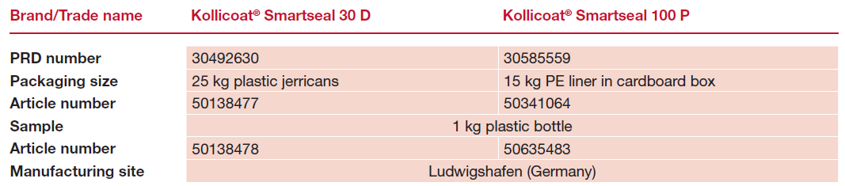
Product details
BASF Pharma Solutions - Orals Platform

Slide 69
Regulatory information: Kollicoat® Smartseal 30 D and 100 P
Regulatory Documentation
US-DMF #024460 (Type V): Kollicoat® Smartseal pre-clinical safety data
US-DMF #029965 (Type IV): Kollicoat® Smartseal 100 P
US-DMF #024389 (Type IV): Kollicoat® Smartseal 30 D
Regulatory Information File (RIF) containing non-confidential CMC information
Kollicoat® Smartseal is not yet monographed in any pharmacopoeia
For a Letter of Authorization or a copy of the RIF, please register on RegXcellence® or contact the sales representative.
BASF Pharma Solutions - Orals Platform

Slide 70
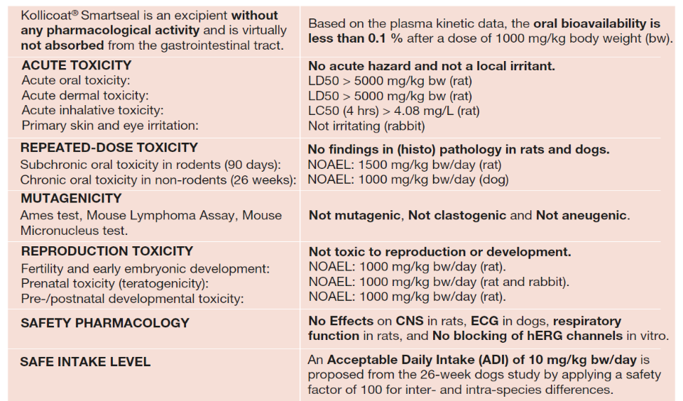
Safety Summary – available on RegXcellence®
BASF Pharma Solutions - Orals Platform

Slide 72

Taste-masking
Film-formers: evaluation of different products on the market

Slide 73

Kollicoat® Smartseal for taste-masking film coating
Taste masking is a key challenge in SODFs
Film-coating is a feasible approach to mask the bitter drug taste. Kollicoat® Smartseal provides:
  Superior taste-masking performance
  Easy film-coating process
  Pleasant odor
Kollicoat® Smartseal 30 D is the first polymer dispersion for taste masking applications
Kollicoat® Smartseal 100 P is the spray-dried version
BASF Pharma Solutions - Orals Platform

Slide 74
Competitive analysis: effective taste-masking for quinine HCl
Dissolution of quinine HCl tablets at pH 6.8
pH 6.8
E PO competitor
Tablet: 330 mg / 9 mm
Coating level: 4 mg/cm²
Kollicoat® Smartseal 30 D gives superior protection at pH 6.8 than other known protective polymers
BASF Pharma Solutions - Orals Platform

Slide 75

Chemical structures
Kollicoat® Smartseal 30 D
Main competitor
Diethylamino group
(CH₃-CH₂-N-CH₂-CH₃) =
more hydrophobic
Dimethyl amino group
(CH₃-N-CH₃) =
more hydrophilic
Copolymer of methyl- methacrylate &
diethylaminoethyl methacrylate (7:3)
Copolymer of methyl- methacrylate, butyl methacrylate &
dimethyl aminoethyl methacrylate (1:1:2)
MW 200,000
MW 150,000
DEAEMA not water soluble
DMAEMA water soluble
Kollicoat® Smartseal offers the best performance for taste masking because of its lipophilic nature
BASF Pharma Solutions - Orals Platform
Notes:
MMA has a Tg of 105C. Diethyl is 66C.
N-butyl methacrylate is a plasticizing methacrylate monomer. It imparts UV protection, transparency and non-yellowing characteristics. Has a low Tg of 40 C
Evonik: DMAEMA monomer --> water soluble -------- dimethyl
BASF: DEAEMA monomer --> water insoluble ------- diethyl

Slide 76
Dissolution Analysis - Performance at pH 6.8 (coating level 3 mg/cm²)
Uncoated
E PO 1 (EU)
E PO 2 (IN)
Kollicoat® Smartseal 100 P
Kollicoat® Smartseal offers the best performance in delaying dissolution at pH 6.8 for taste-masking applications
BASF Pharma Solutions - Orals Platform

Slide 77
Comparison with competitor products: Superior taste-masking performance
Number of bitter sensations*
Coating Polymer:
Kollicoat® Smartseal 30 D
Tablet: 100 mg quinine HCl, 189 mg Ludipress®, 37 mg Avicel® PH 101, 1 mg Mg-stearate, 0.3 mg Aerosil 200 Pharma; Coating: 90.9% Kollicoat® Smartseal 30 DP with 13% TEC; 2.5% BHT, 40% talc, 2% iron oxide.
E PO competitor
HPMC for taste-masking
F. Guth, K. Kolter; Launch Presentation “Kollicoat® Smartseal 30 D” 2010
*Number of individuals reporting bitter taste when putting coated quinine HCl (100 mg) tablets for 10 – 30 seconds into the cheek (7 test persons).
In line with the dissolution profiles, a superior taste masking was reported by a trained panel.
BASF Pharma Solutions - Orals Platform

Slide 78















Smell analysis: Pure polymer and coated caffeine granules
Kollicoat® Smartseal 30D
Main competitor
organic coated granules
After
1 week…
After
1 week…
Kollicoat® Smartseal 100 P
organic coated granules
Indian competitor polymer
Isopropanol
After
1 week…
Granule smell burned nose!
BASF Pharma Solutions - Orals Platform

Slide 80
Backup slides
Separated by topics:
Dispersions
Plasticizer
Formulary
Competitor
Calculation

Slide 81
Film coating – Introduction to the Dispersions

Slide 82

Functional Polymers: Understanding Dispersions
Polymer solubilized in a solvent = solution
Polymer suspended in a solvent = suspensions
Polymer disperse in a solvent = dispersions
In a dispersion, the polymer particles are stabilized in an aqueous environment by ionic or nonionic emulsifiers. Emulsifiers are responsible for maintaining the polymers dispersed;
However, a dispersion is a meta-stable system (zeta potential / isoelectronic point of a dispersion). If this meta system is destabilized, occurs polymer coagulation;
So, dispersions CAN NOT be:
  Frozen
  Treated with high mechanical stress
  Freely mixed with other materials, as organic solvents.
+
-
-
-
+
+
-
+
-
-
+
+
BASF Pharma Solutions - Orals Platform

Slide 83


Understanding Dispersions: Stabilization
Polymer particles in a dispersion are stabilized by ionic or nonionic emulsifiers via electrostatic and/or steric stabilization.
BASF Pharma Solutions - Orals Platform

Slide 84


Film formation from dispersion polymer particles
Polymer droplets
Water evaporation and concentration
Deformation
MFT
Polymer droplets
Schematic presentation of the film forming mechanism
from aqueous polymer dispersions (Muschert, 2008).
Cure → Above MFT
Coalescence and
interdiffusion
A curing step might be required for dispersions to eliminate the excess of water and form a total coalescent film.
Homogeneous film
Smooth film
BASF Pharma Solutions - Orals Platform
Notes:
Curing: is a process normally recommended for dispersions where tablets or pellets are kept in the coater machine/ fluid bed / some cases you can put in am oven, in a temperature above the MFT (minimum film forming temperature) (50 – 60 C) for a period of time to be defined (30 min to 4 hs).
The curing step is required to evaporate the excess of water that surrounds the polymer particles and to provide the complete coalescence of the particles – see the microscopy (polymer particles in droplets – after curing, a smooth polymer film).
Some dispersion might not require a curing step, or the curing time is low (30 min).
Without a curing you can find some lack of functionality.
You might observe the need for curing during stability. Differences on drug release (reduce drug release or delay it) between T0 and T X stability is not uncommon for uncuring batches.

Slide 85
TEC as plasticizer – Hydrolysis

Slide 86
Kollicoat® Smartseal Formulation: Plasticizer
Hydrolysis of triethyl citrate (TEC) in aqueous environment, steady-state at a pH-value of about 4.3
cat. OH⁻
ester
free acid
(citric acid)
Research shows that some plasticizers (e.g., citric acid esters) are prone to hydrolysis in aqueous environment.
Ester molecules like triethyl citrate (TEC) obey an equilibrium reaction between acid and ester state in aqueous media.
As a result of that, some amounts of citric acid and free ethanol (EtOH) may develop as soon as the TEC is introduced into aqueous polymer dispersions.
The degree of free acid and alcohol production is thereby also influenced by the pH-value of the system.
BASF Pharma Solutions - Orals Platform

Slide 87

Kollicoat® Smartseal Formulation: Plasticizer
pH-value of plasticized Kollicoat® Smartseal dispersion,
as function of storage time (0 – 24 hours) with plasticizer
Coating formulation
  Kollicoat® Smartseal 30 D: 88.5%
  Plasticizer (13% polymer base): 11.5%
  Formulation: aqueous dispersion
  Solid matter content: 20%
  Plasticizers:
  Triacetin (TAC)
  Triethyl citrate (TEC)
pH-value
  Equipment Titrando 836 (Metrom)
  Electrode Hamilton
  Temperature: 23°C (controlled conditions)
  Sample device: closed and sealed argon as cover gas
In the case of Kollicoat® Smartseal, citric acid is consumed by a neutralization reaction and thus drawn out from the equilibrium.
The alkaline environment enhances the hydrolysis reaction speed of TEC.
As a consequence, the reaction is dislocated to produce more citric acid, declining the pH-value
BASF Pharma Solutions - Orals Platform

Slide 88


Kollicoat® Smartseal Formulation: Plasticizer
pH-value change of the plasticized dispersion (over 48 h)
Henry’s equation
$$μ_{e}=\frac{ε∙f\left(κα\right)∙ζ}{6∙π∙η}$$
electrophoretic mobility µ_{e}
dielectric constant ε
Henry’s function f(κα)
zeta-potential ζ
dynamic viscosity η
Coagulated Kollicoat® Smartseal dispersion containing TEC
Latex dispersions are sensitive systems stabilized by tailored surfactant solutions.
They create a dedicated surface charge, separating the particles from each other, thus overcoming the risk of coagulation.
Whether a system is thermodynamically stable can be described by zeta-potential which in turn can be determined by means of mobility measuring.
BASF Pharma Solutions - Orals Platform

Slide 89
Formulary

Slide 90
Formulary: Kollicoat® Smartseal 30 DP
Material | % | Solid content (g) | % Solids
Kollicoat® Smartseal 30 DP | 53.33 | 16.0 | 80.0
DBS or ATBC | 2.00 | 2.0 | 10.0
Talc | 2.00 | 2.0 | 10.0
Water - q.s. 20% solids content | 42.67 | - | -
Total | 100.00 | 20.00 | 100.0
12.5% of plasticizer based on polymer weight
10% of talc based on the total amount of solids – more talc can be required to reduce film tackiness
BASF Pharma Solutions - Orals Platform

Slide 91
Formulary: Kollicoat® Smartseal 30 DP (+ BHT as antioxidant)
Material | % | Solid content (g) | % Solids
Kollicoat® Smartseal 30 DP | 52.17 | 15.65 | 78.26
DBS or ATBC | 1.96 | 1.96 | 9.78
BHT | 0.39 | 0.39 | 1.96
Talc | 2.00 | 2.0 | 10.0
Water – q.s. 20% solids content | 43.48 | - | -
Total | 100.00 | 20.00 | 100.0
12.5% of plasticizer based on polymer weight
10% of talc based on the total amount of solids (dry film) – more talc can be required to reduce film tackiness
2.5 % BHT based on polymer weight – required for sugar cores
BASF Pharma Solutions - Orals Platform

Slide 92
Formulary: Kollicoat® Smartseal Smartseal 100 P in water
Material | % | Solid content (g) | % Solids
Kollicoat® Smartseal 100P | 10.48 | 10.48 | 52.40
DBS or ATBC | 1.31 | 1.31 | 6.55
Talc | 8.00 | 8.00 | 40.0
Succinic acid | 0.21 | 0.21 | 1.05
Water – q.s. 20% solids content | 80.00 | - | -
Total | 100.00 | 20.00 | 100.0
12.5% of plasticizer based on polymer weight
40.0% of talc based on the total amount of solids (dry film)
2.0% of succinic acid based on polymer weight
BHT is recommended – add 2.5 % of BHT based on dry polymer
BASF Pharma Solutions - Orals Platform

Slide 93
Formulary: Kollicoat® Smartseal 100 P in organic solvents
Material | % | Solid content (g) | % Solids
Kollicoat® Smartseal 100P | 10.67 | 10.67 | 53.35
DBS or ATBC | 1.33 | 1.33 | 6.65
Talc | 8.00 | 8.00 | 40.0
Acetone : Isopropanol (1:1) q.s. 20% solids content | 40.00 Isopropanol 40.00 Acetone
Total | 100.00 | 20.00 | 100.0
12.5% of plasticizer based on polymer weight
40.0% of talc based on the total amount of solids (dry film)
BHT might be required
It’s preferable to use only acetone as solvent
BASF Pharma Solutions - Orals Platform

Slide 94
Competitor analysis

Slide 95
Kollicoat® Smartseal – EPO Competitor:
Comparison of important properties
 | Kollicoat® Smartseal 30 D | Kollicoat® Smartseal 100 P | E PO Competitor
Aqueous coating | First aqueous dispersion (latex) of a basic functional polymer. Easy and economic process | Easily re-dispersible in water (partial neutralization with 8 mol% succinic acid) | Tedious preparation of a colloidal dispersion with SLS 10% and stearic acid 15%
Organic coating | No. | Yes. Acetone recommended. | Yes, with acetone, isopropyl alcohol and ethanol, plus 2-3% water
Stability | 30 months (30°C/ 75% RH) | 18 months (30°C/ 75% RH) | 36 months (< 25°C)
HME | n/a | Low odor, better extrudate appearance and high solubilization capacity. | Poor feeding. High odor, poor extrudate appearance and low solubilization capacity.
Synthesis | Emulsion polymerization | Spray drying | Solution polymerization (IPA) (changed from bulk polymerization) extrusion, milling (at ACU pharma)
Residual monomers | Limit: Each max. 100 ppm Typical results, MAS < 50; MMA: < 20; DEAEMA < 100 ppm | Limit: Each max. 100 ppm Typical results, < 100 | Limit: Each max. 1000 ppm Typical results: MMA <15 ppm; BA ~100 ppm; DMAEMA: <300 ppm
Tg | 57-63°C | 57-63°C | 40-43°C
MFT | 57°C | 57°C | n/a
Molecular weight | 40 000 – 60 000 | 40 000 – 60 000 | ~50 000
BASF Pharma Solutions - Orals Platform

Slide 96
Partial Neutralization Calculation

Slide 97
Partial Neutralization Calculations
An acid content of 8 mol% relative to the amount of amino-functional groups is recommended.
  Succinic acid (Mw = 118.09 g/mol) → 2.0% w/w rel. to polymer
  Adipic acid (Mw = 146.14 g/mol) → 2.5% w/w rel. to polymer
  Malonic acid (Mw = 104.66 g/mol) → 1.8% w/w rel. to polymer
Calculation example for succinic acid (based on 6:4 mass ratio)
100 g of Kollicoat® Smartseal 100 P contain about 40 g of the amino-functional monomer DEAEMA Molecular weight (Mw) of DEAEMA = 185.27 g/mol 40g / 185.27 g/mol = 0.22 mol
Degree of neutralization: 8 mol% 0. 22 mol x 8 / 100 = 0.0173 mol
Molecular weight succinic acid: Mw = 118.09 g/mol 0.0173 mol x 118.09 g/mol = 2.04 g succinic acid need to be added per 100 g of Smartseal 100 P This equates to preparing a 2.0% w/w rel. to polymer solution of succinic acid
This means that 0.0176 moles of acid need to be added per 100 g of Smartseal 100 P
BASF Pharma Solutions - Orals Platform
Notes:
Calculations are based on 6:4 because its on a mass ratio. 7 : 3 is on a molar ratio
If based on 7:3, then its 1.53 g of succinic acid, which equates to 1.5% w/w rel to polymer solution

